Slide 1
Photon Project
Team 16: Brian Devaney, Eric Wilkins, Frank Luceri, Nicholas Williams, Zachary Kessler

Slide 2
Approach

Slide 3




Sprint 1
Programming Language: Python
Graphics: Tkinter
Database: Psycopg2
Music: Pygame
Communication: Slack, text
Planning: Trello
Code Repository: Github

Slide 4

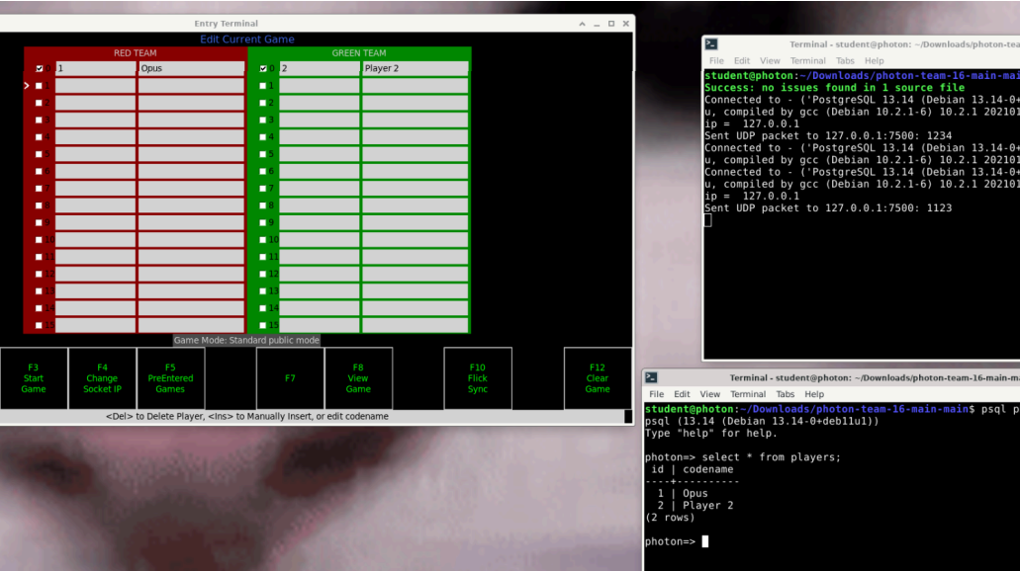
Sprint 2
Splash screen: Zach
Player Entry Screen: Eric
Database: Brian
UPD: Nick and Frank

Slide 5
Sprint 3
**insert countdown timer gif here** (can opt for screenshot too)
Input Hardware Id: Frank
Play Action Display: Eric
Start game: Brian
Clear player entry screen: Zach
Game-start countdown timer: Nick

Slide 6
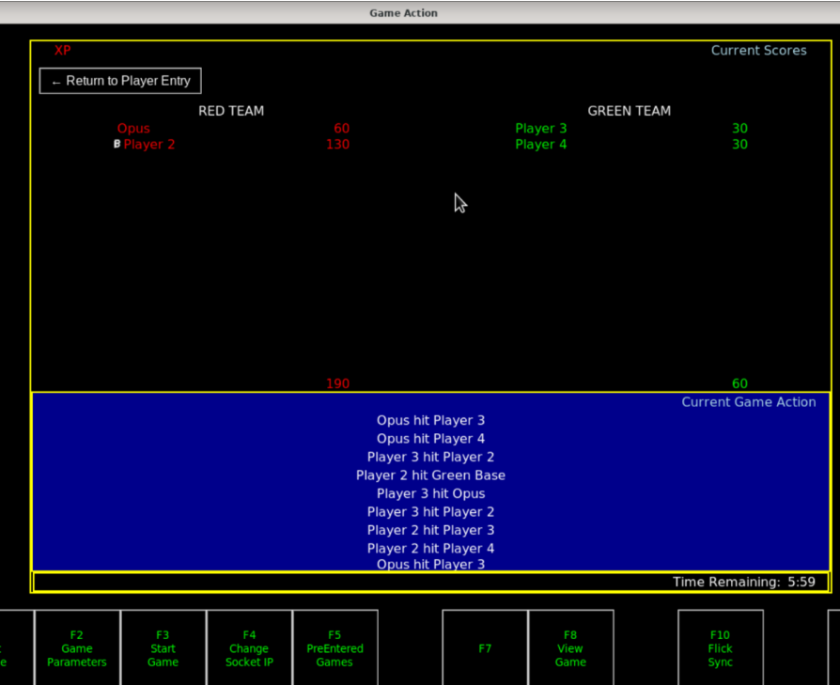
Sprint 4
Game action events: Eric
Game play timer: Zach
Connect traffic generator to UPD: Nick
Add music: Brian
Exit button: Frank

Slide 7
Problems

Slide 8
What We Learned
How to collaborate in Github using clone, fork, etc.
Scrum and Agile Software Development
Python libraries & tkinter methodologies
Utilizing management apps like Trello and Slack

